Slide 1





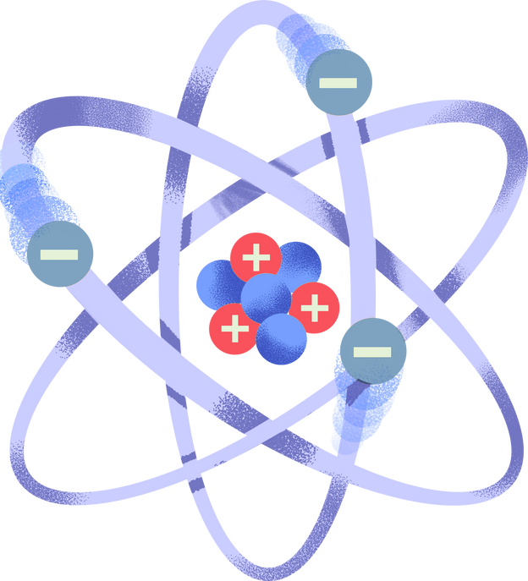
EXPERIMENTAL
Physics
Ms. Raghad Rashed

Slide 2

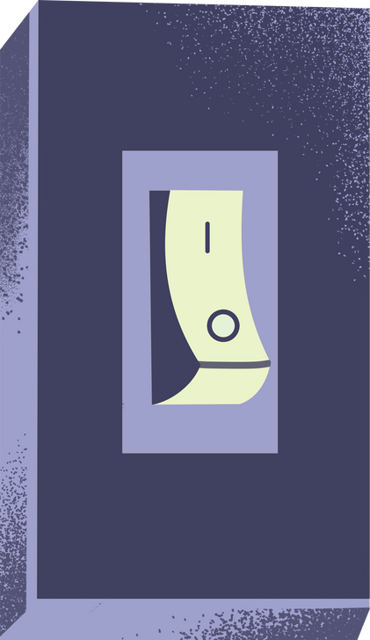
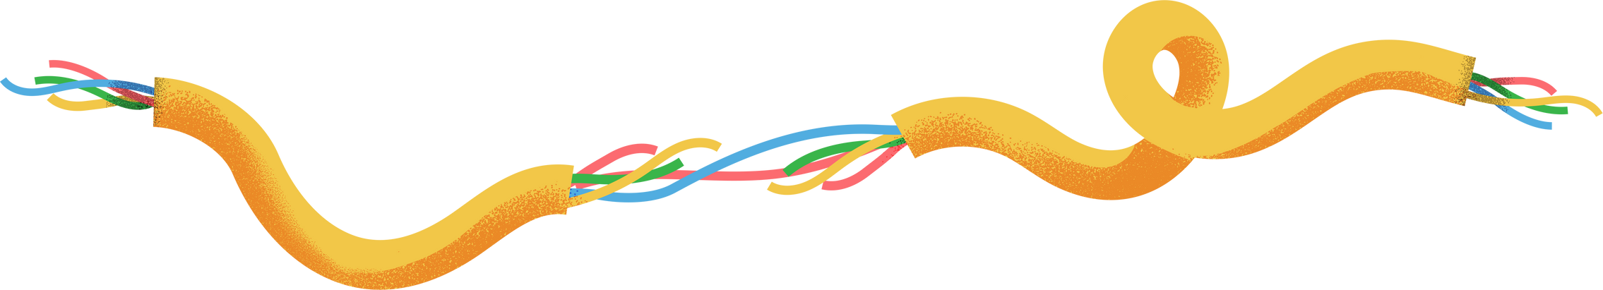

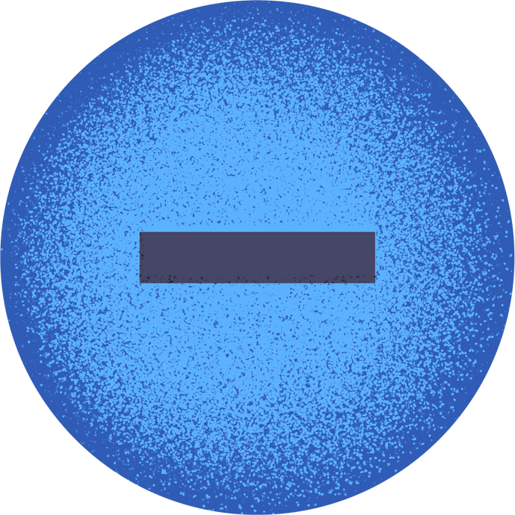
The test of all knowledge is experiment. Experiment is the sole judge of scientific truth.
Richard Feynman

Slide 4
what we are going to do
To get Familiarize with physical computing.
Learn basic coding to control sensors.
Perform two hands-on experiments applying physics with computational electronics.

Slide 5
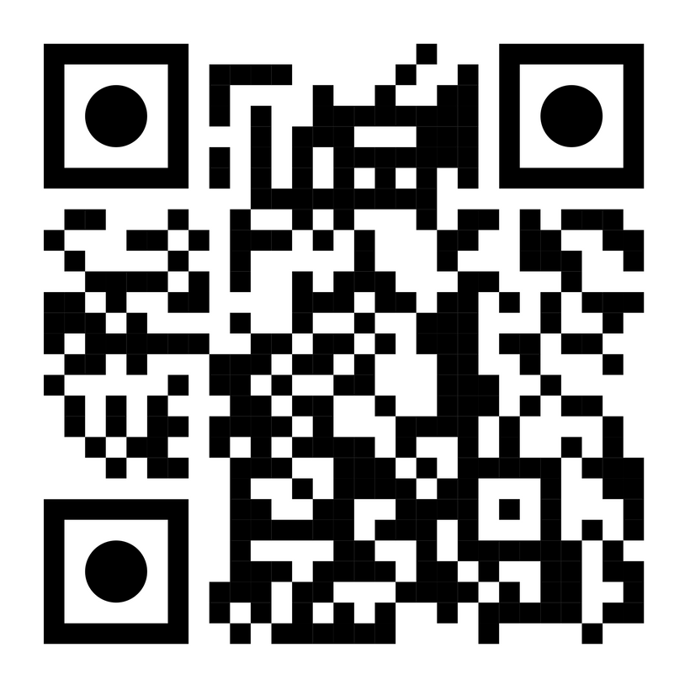
prepare your kit

Slide 6


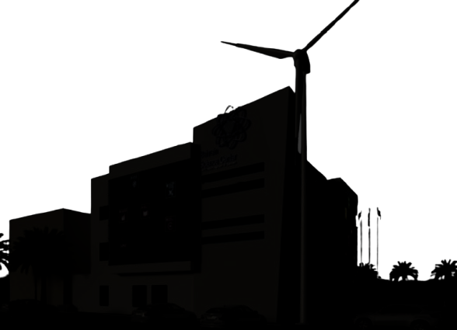

Can we measure the area of the budling without a tape measure?
هل يمكننا قياس مساحة المبنى بدون استخدام الشريط المتري؟

Slide 7
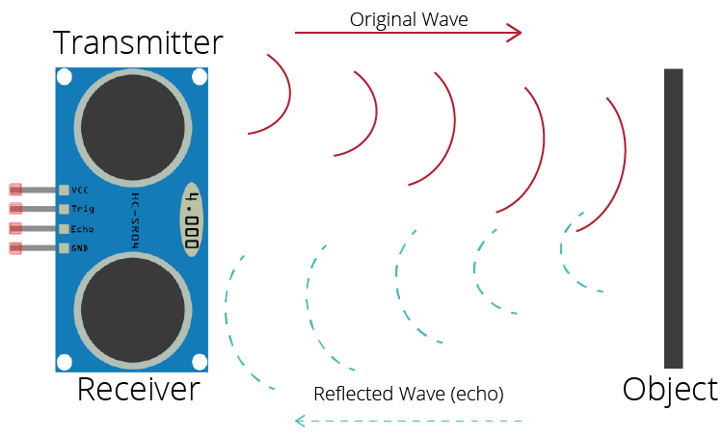
ULTRASOUND WAVES
Ultrasonic sensors measure distance by sending a high-frequency sound pulse and analyzing the time it takes for the waves to return after reflecting off an object.
يتم قياس المسافة عن طريق إرسال موجة فوق صوتية بتردد عالٍ. عندما يكشف وجود جسم ما، تنعكس الموجة عن الجسم ويتم حساب الوقت الكلي.

Slide 8
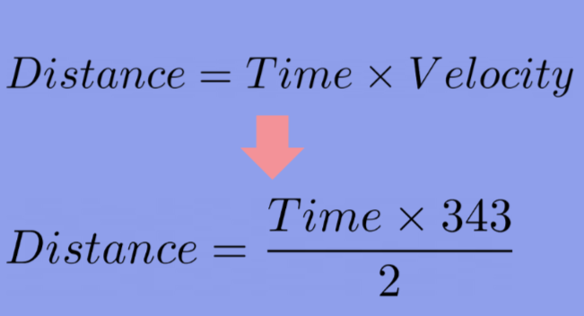
ULTRASOUND WAVES

Slide 9
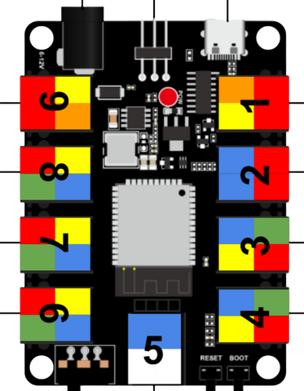
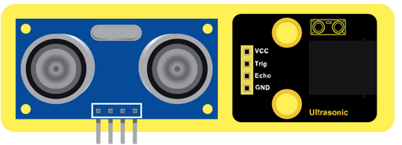
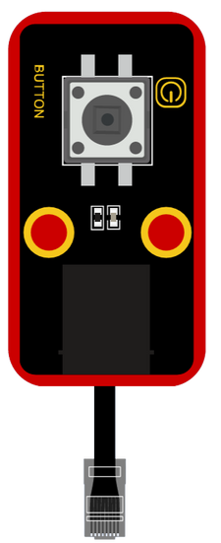
setup--steps
Connect the ultrasonic sensor’s signal pin to digital pin 1.
Connect the button to digital pin 3.
Upload the code (lab1.ubp), write down your measurements and estimate the area!
To measure long distances, break the distance into segments of 5 meters Sum these individual measurements to determine the full length.
للمساحات الطويلة, قسّم المسافات إلى كل 5 متر, ثم قم بحمع القياسات المفردة لحساب الطول الكلي.

Slide 10

the place covers ~1000m²
Source: OANA

Slide 11


irradiance
experiment

Slide 12
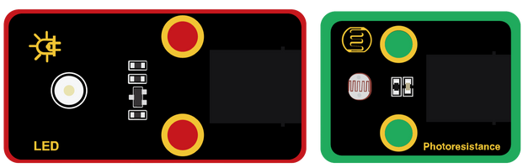
setup--steps
1.Connect LED to PIN 9, Button to PIN 1 , Photoresistance to PIN 4.
3.Connect microcontroller to your laptop, upload code [irradiance.ubp]
4.Open graph, click on button
5.place LED as close as possible from Photoresistance, without shadowing, then
click button again
6.Get LED further each time, then click on button again

Slide 13
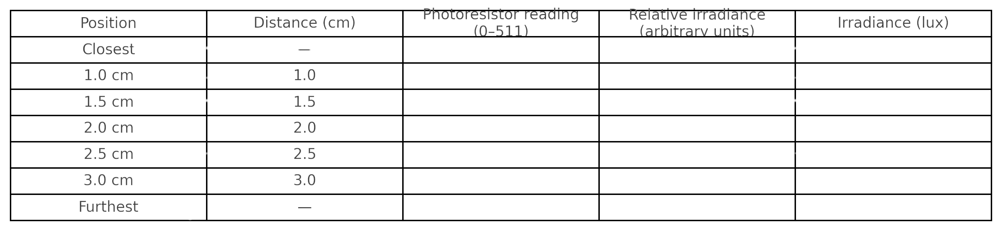
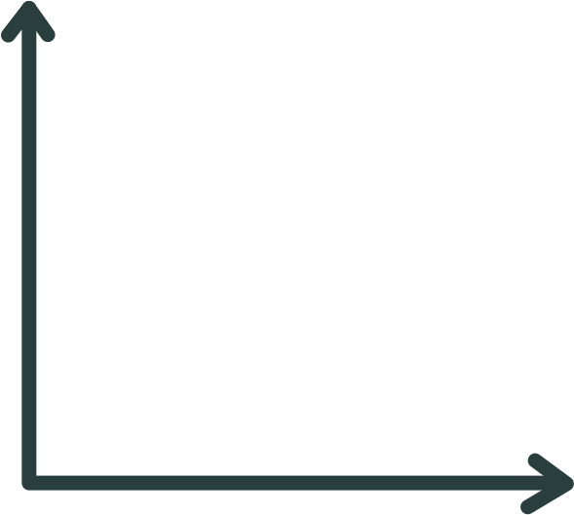
data
light intensity
Distance (cm)

Slide 14
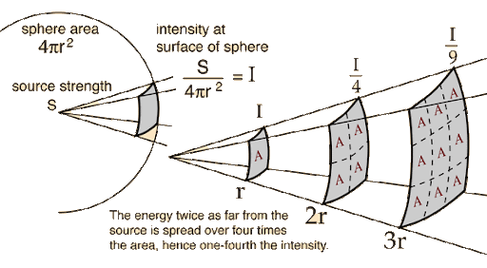
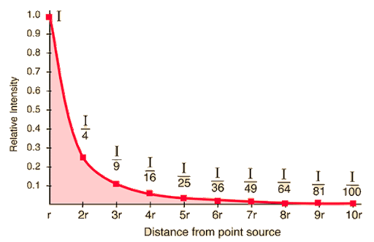
inverse square law

Slide 15
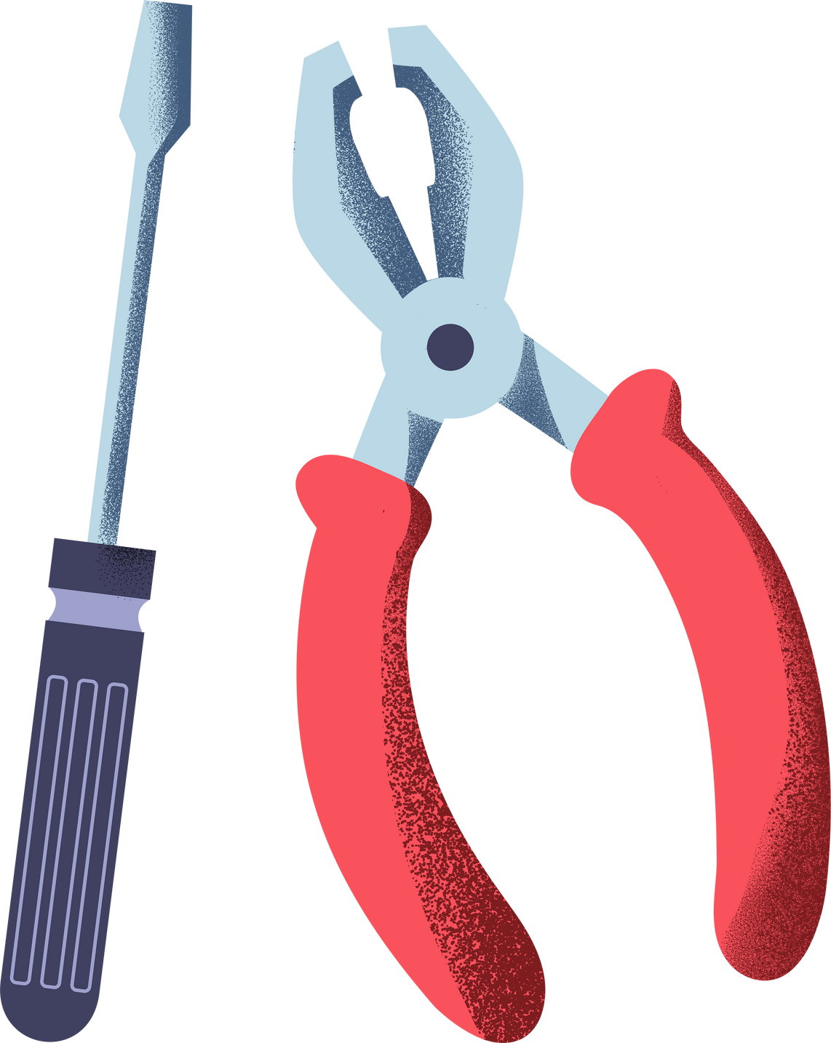
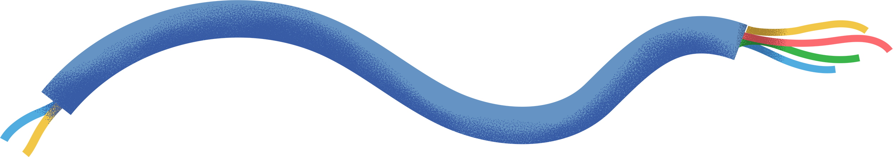
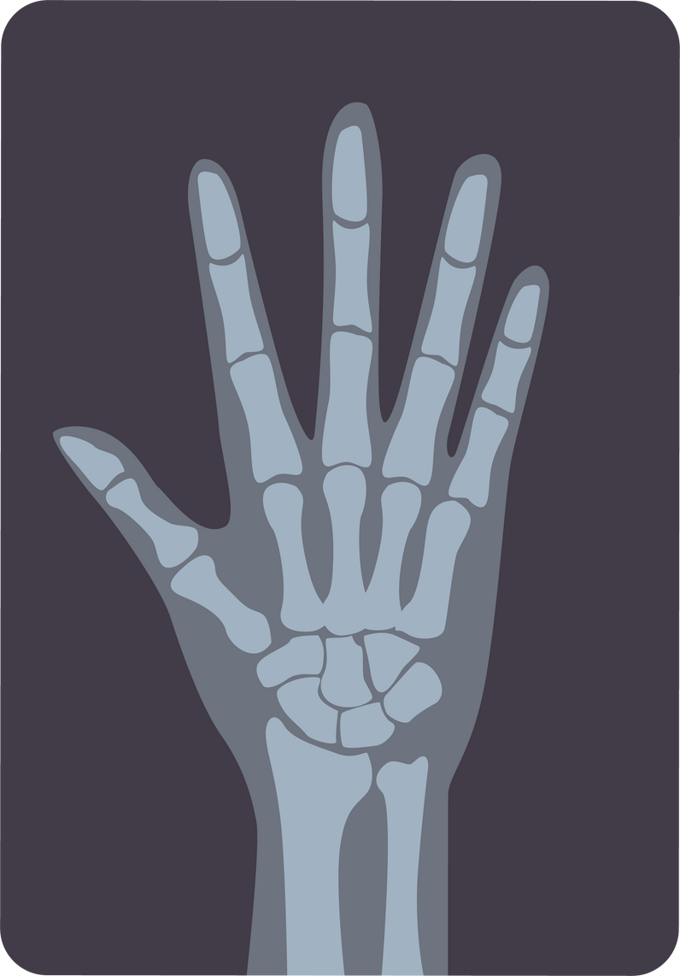

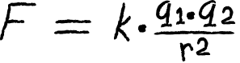
application
Medicine
Astronomy
Electromagnetism
determine safe distances and exposure times
determine the distances of stars

Slide 16
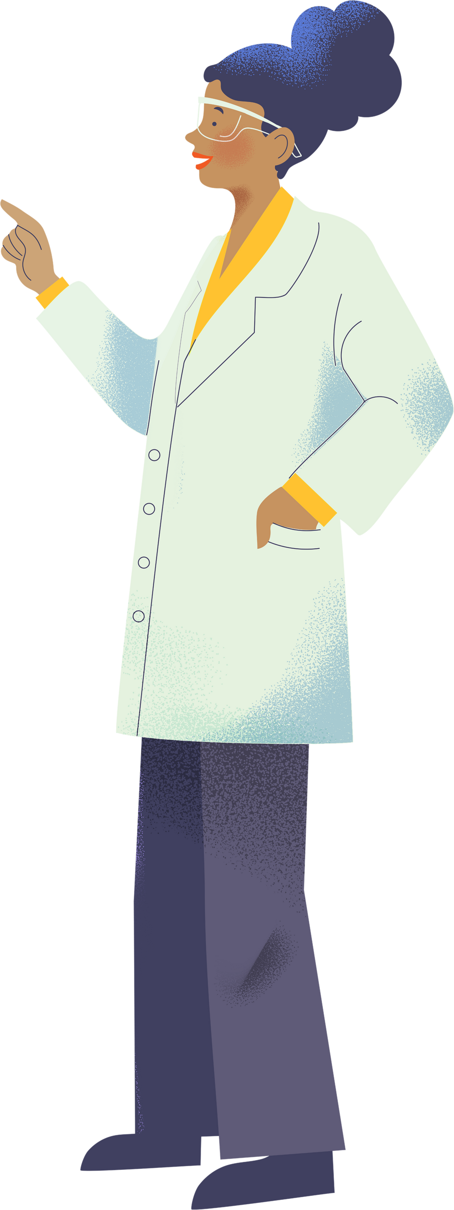
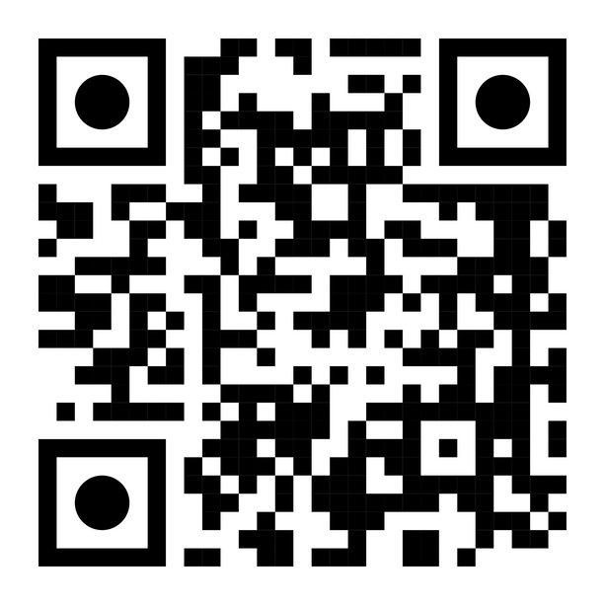
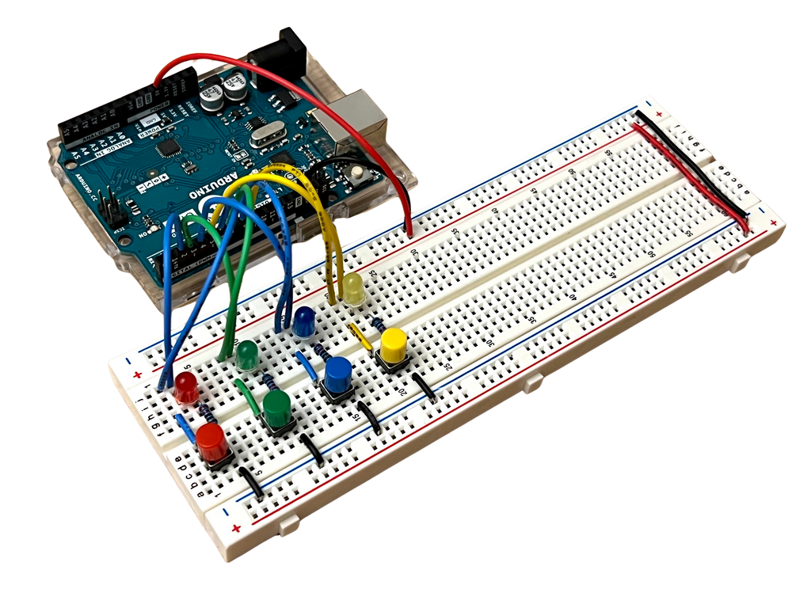
Conclusion
learn Arduino via:

